Slide 1

A Risk Adjustment Model for Home Health Agencies

Slide 2

About Us
Elisa White
Erica Rosa
Jensen Binoji
Ted Stagner
Tim Halligan
Our mission is to find solutions to improve the deliverance of cost efficient healthcare as Medicare moves towards a value based reimbursement structure.
Notes:
ELISA

Slide 3
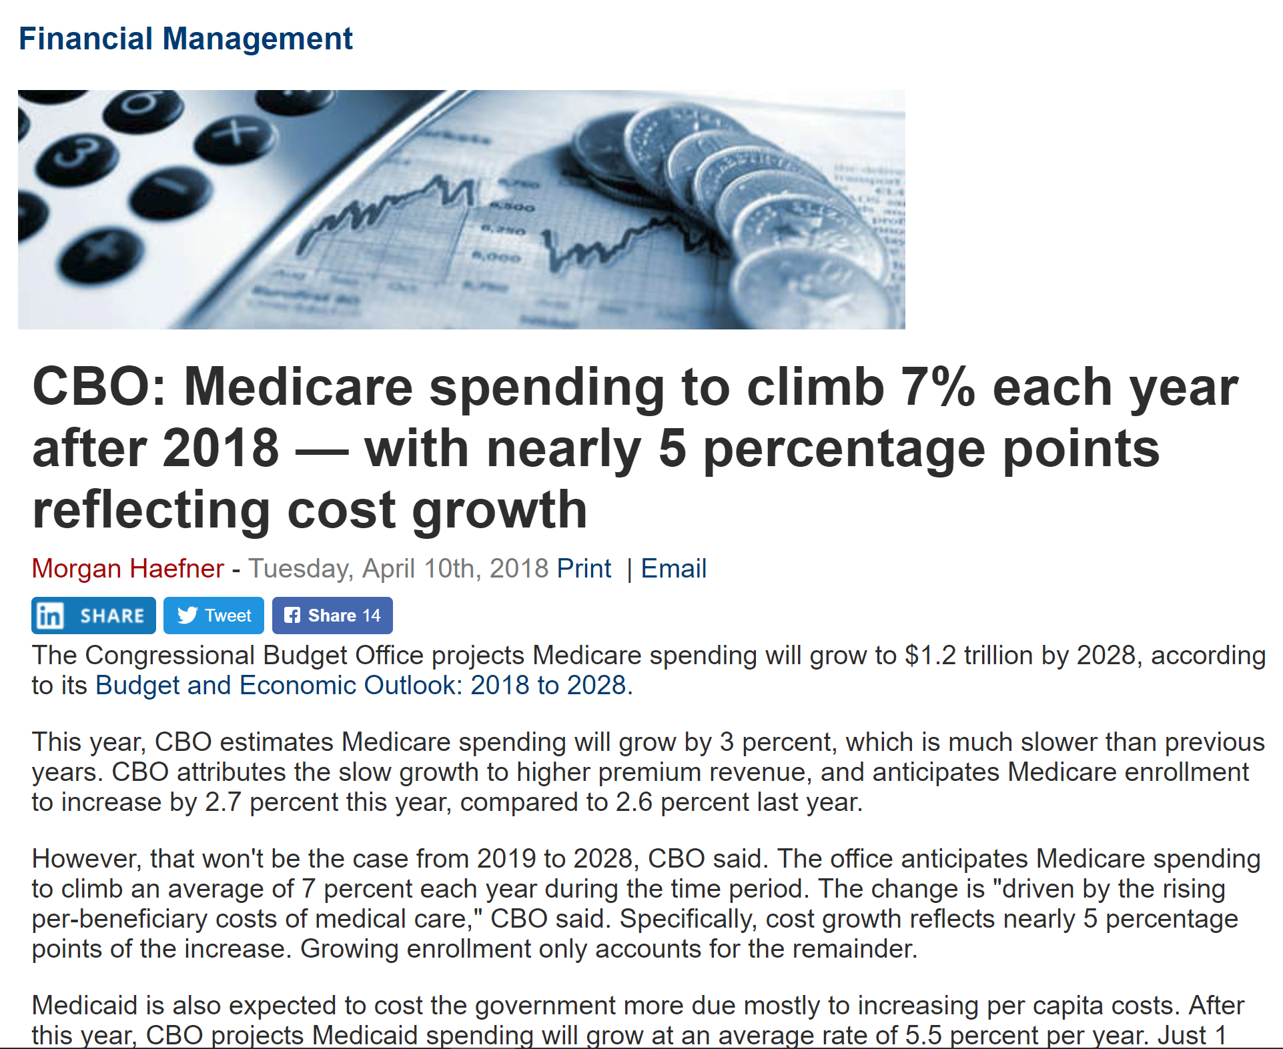
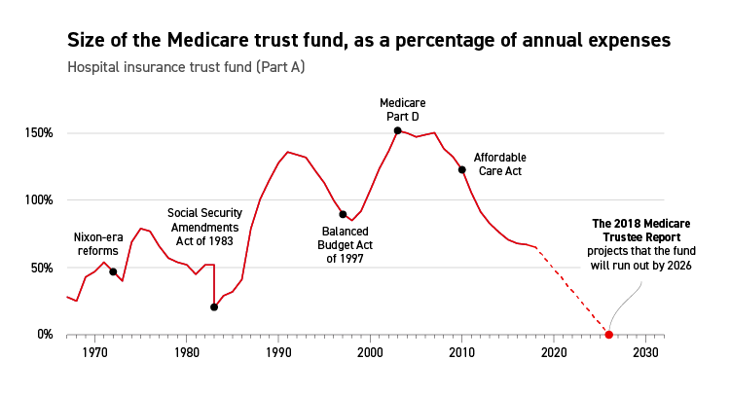
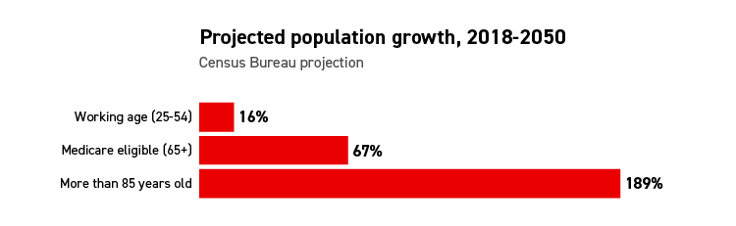
The Problem
Increasing Medicare Population
Increasing Medicare Spend
Decreasing Funding
The Medicare Population is projected to increase at a greater rate than any other demographic.
Medicare Beneficiary spending is expected to continue rising annually.
The Medicare fund is projected to be depleted by 2026.
https://www.politico.com/agenda/story/2018/09/12/medicare-baby-boomers-trust-fund-000694
Notes:
ELISA

Slide 4




Solution
Prioritize
Model
Monetize
Home Health Dataset Analysis for understanding of current population.
Create Risk Adjustment model using Home Health Dataset
Use model to recommend expenditure adjustments
Create a Risk Adjustment model for high risk beneficiary predictions to adjust reimbursement for improved cost effective care.
Notes:
ELISA

Slide 5

Dataset Preliminary Analysis

Slide 6


Hierarchical Condition Category (HCC) Scores
Capitation vs Pay for Performance
Risk Adjustment Mechanisms
CMS HCC Scores
Specialty-specific risk adjustment model
Notes:
ERICA
In some payment models, payers reimburse providers a flat rate per patient (capitation), and in others, payers assess penalties or provide bonuses based on cost or quality of care outcomes (pay-for-performance).
In such models, risk adjustment is important. Risk adjustment mechanisms predict whether a given patient, or group of patients, is likely to be more or less costly to treat than the average population and provides a way to adjust payment accordingly. Risk adjustment compensates health plans and providers for treating sicker patients, and reduces their incentives to select healthy or less costly patients. Risk adjustment mechanisms predict whether a given patient, or group of patients, is likely to be more or less costly to treat than the average population and provides a way to adjust payment accordingly.
The Centers for Medicare & Medicaid Services (CMS) risk adjustment model is a hierarchical condition category (HCC) score. Use of the HCC model is expanding, and there is concern over whether it functions as intended. If CMS-HCC risk scores do not accurately reflect patient health status because of factors such as coding practices or capacity, then payments may not be associated with the true cost of treatment.
Additionally, treatment paths and associated costs can vary greatly within patient populations of a specific provider type. We developed a model focused on home health agencies, to explore this concept and try to discover additional patterns that can inform initiatives to reduce burdensome healthcare spending.

Slide 7
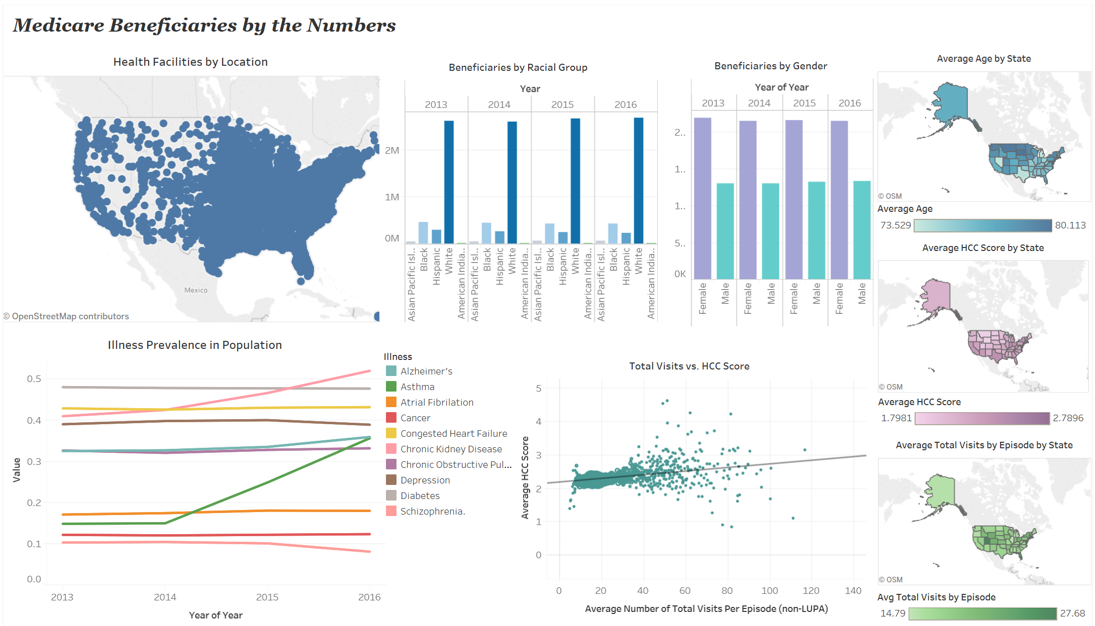
Notes:
ELISA

Slide 8

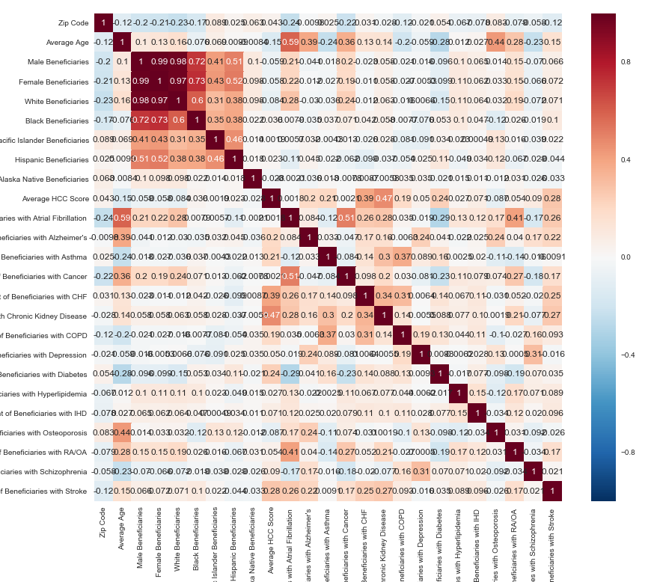
The Model
Notes:
TRANSITION

Slide 9
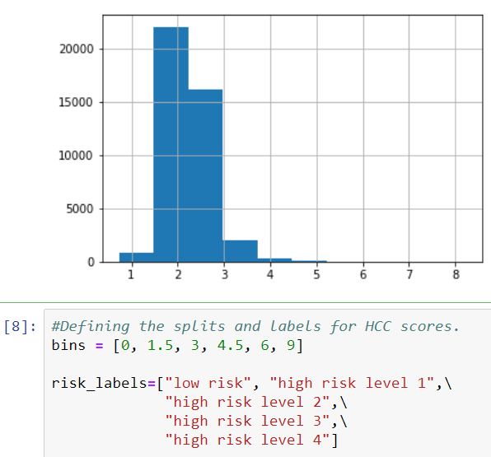
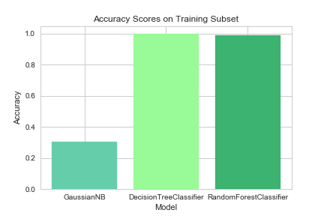
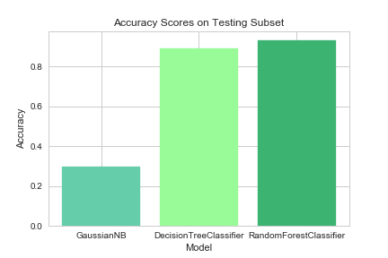
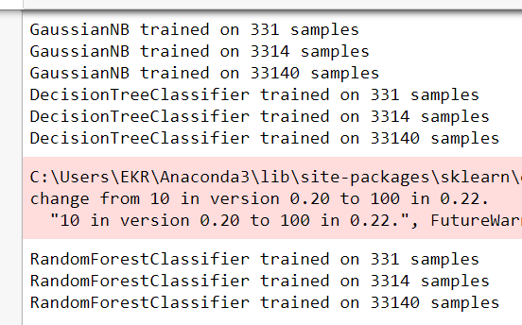
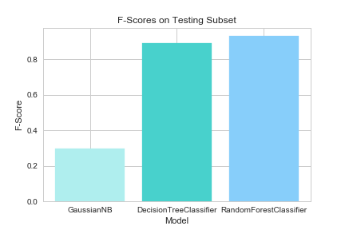
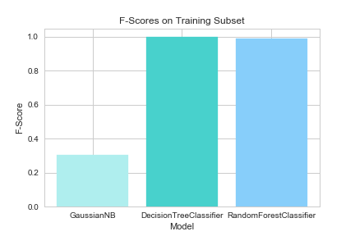
Gaussian
Decision Tree
Random Forest Classifier
Notes:
ERICA
One of the big problems in machine learning is overfitting, but most of the time this won’t happen that easy to a random forest classifier. That’s because if there are enough trees in the forest, the classifier won’t overfit the model.

Slide 10
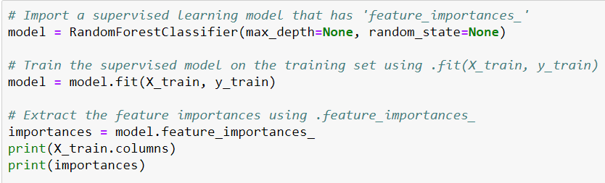
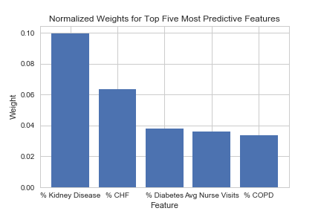
Feature
Importances
Notes:
ERICA
Random Forest is a predictive modeling tool and not a descriptive tool. That means, if you are looking for a description of the relationships in your data, other approaches would be preferred.

Slide 11
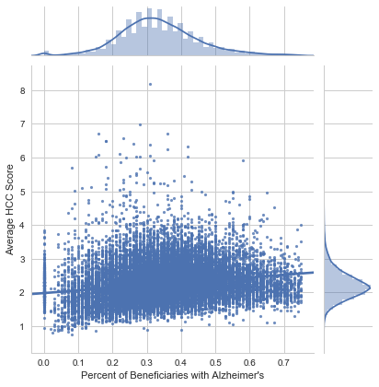
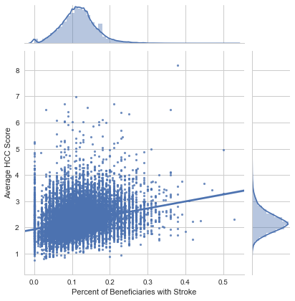
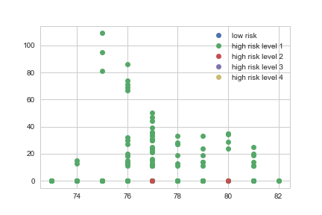
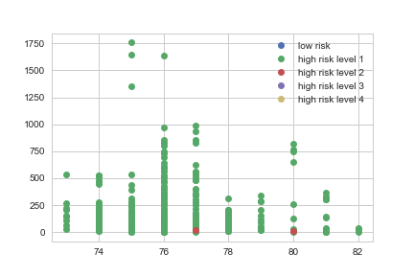
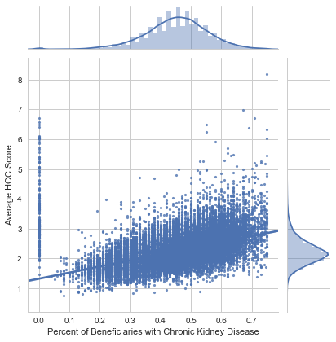
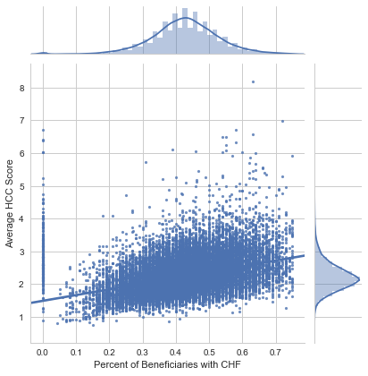
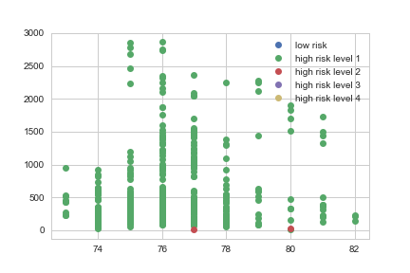
Alzheimer’s vs HCC Score
Stroke vs HCC Score
Black Beneficiaries by Risk and Age
White Beneficiaries by Risk and Age
Chronic Kidney Disease vs HCC Score
Congested Heart Failure vs HCC Score
Asian Beneficiaries by Risk and Age
Notes:
ERICA
Additional descriptive exploration for potential relationships between features

Slide 12
Regression
Notes:
TED

Slide 13
Deep Learning
Notes:
TED

Slide 14
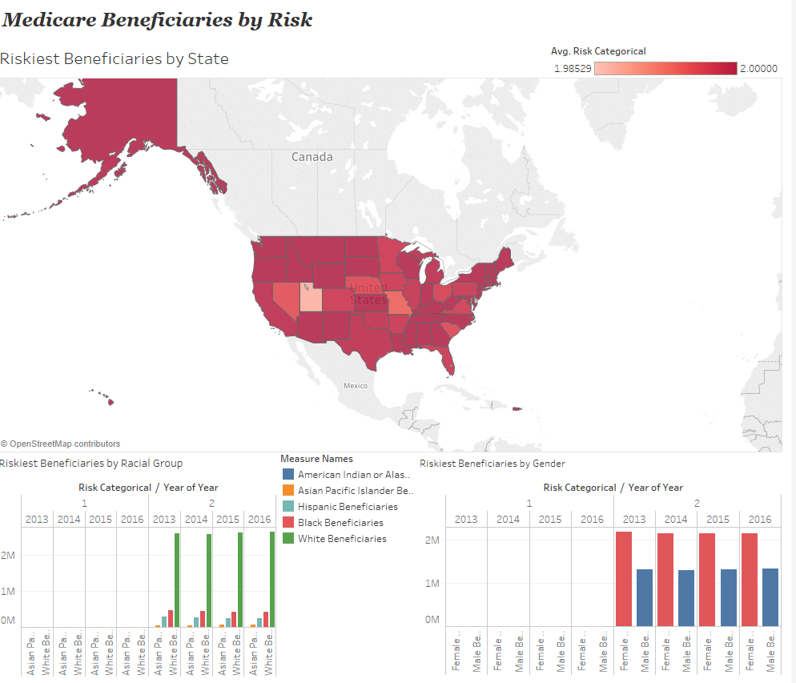
Notes:
ELISA

Slide 15

Readmission Rates Analysis on Dialysis

Slide 16
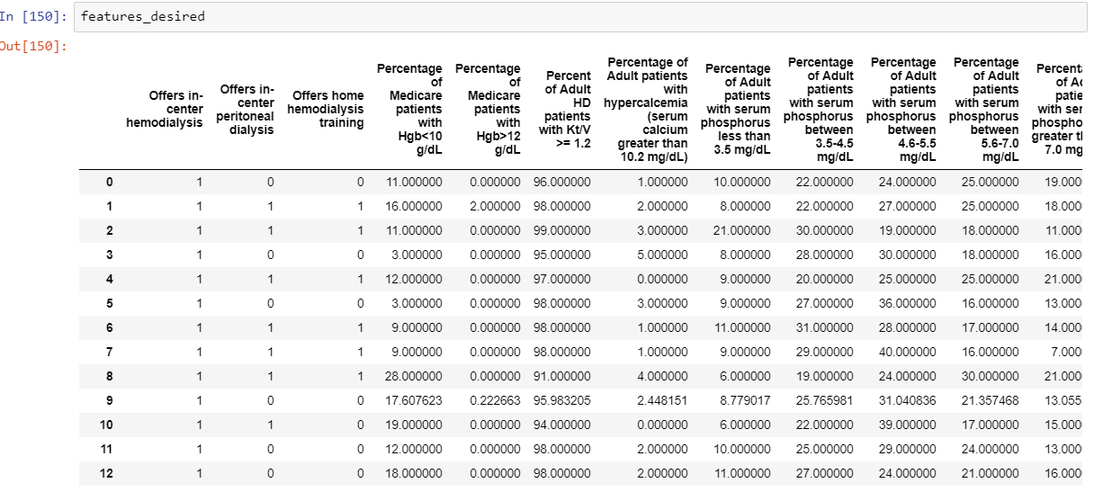
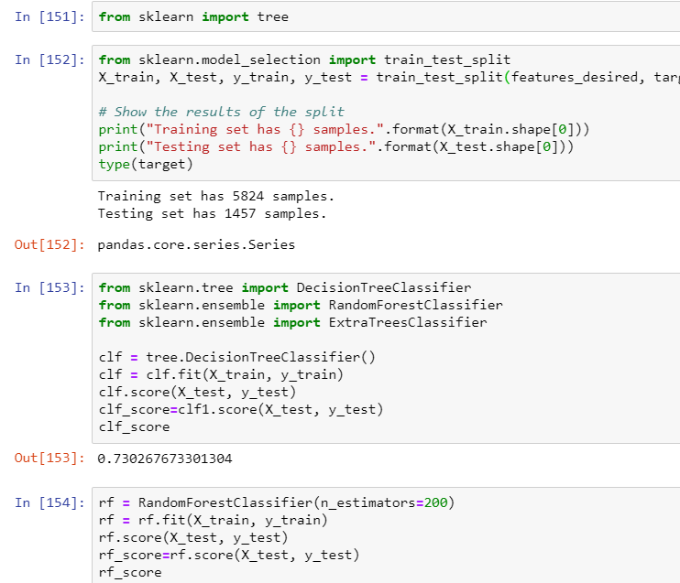
Conducted Machine Learning on Dialysis Data
Features for comparison

Slide 17
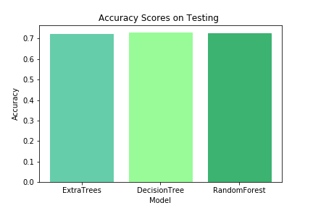
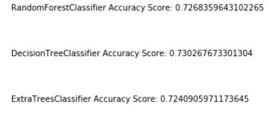
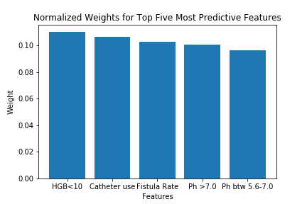
Accuracy tests run on all models indicate almost similar scores HGB counts ,stands as one of the significant features contributing to high readmission rates .

Slide 18

Summary
Medicare beneficiaries at home health facilities have consistent risk levels, with a few outliers.
Facilities with higher HCC scores have higher populations of chronic illnesses and should require additional funding for managing these populations.
Consider alternative methods of treatment for low risk beneficiaries at home health facilities.

Slide 19
Thank You Questions?

